Slide 1
Introduction to Java Programming Language
Contents:-
The Java Thread Model
Thread Priorities
Messaging
The Thread class and the Runnable Interface
Creating a thread, Creating Multiple Threads
Daemon thread.
1

Slide 2
Multithreading
Multithreading means a single program having different threads executing independently at the same time.
A thread represents an individual path of execution. By such division we can save the wastage of CPU time in a process.
It is the smallest unit of processing. It is a separate path of execution. It shares the memory area of process.
In multithreaded programming process is divided into different threads.
Multithreading is a type of multitasking.
Multitasking: Multitasking is a process of executing multiple tasks simultaneously. We use multitasking to utilize the CPU. Multitasking can be achieved by two ways:
    Process Based
    Thread Based

Slide 3
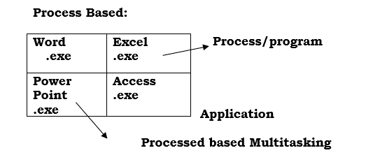
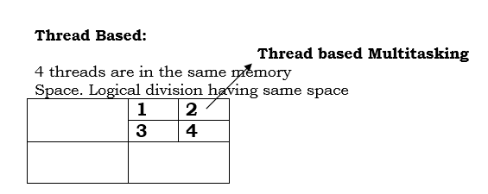
Multithreading
Process Based
Thread Based:

Slide 4
Multithreading
Process Based Multitasking (Multithreading):
Each process have its own address in memory i.e. each process allocates separate memory area.
Process is heavyweight.
Cost of communication between the process is high.
Switching from one process to another require some time for saving and loading registers, memory maps, updating lists etc.
Interprocess communication is heavy in terms of time and memory.
Thread-based Multitasking (Multithreading):
Threads share the same address space.
Thread is lightweight.
Cost of communication between the thread is low.
Note: At least one process is required for each thread

Slide 5
Multithreading
Difference between Process & Thread:
Process is Smallest Unit
Single Threaded system
Thread is in finite loop, if it suspends wastage of CPU
Each process has a complete set of its own variables
It takes more overhead to launch new processes.
Inter-process communication is heavy in terms of time & memory
Thread is Smallest Unit
Multithreaded System
Thread is not in loop, no wastage of CPU
Threads may share the same data.
It takes much less overhead to create & destroy threads
Inter-process communication is light in terms of time & memory

Slide 6

Multithreading
Thread is a power that takes the CPU time to perform the delegated work.
If working Thread suspends any other Thread will take on CPU time and starts working. Hence, no wastage of CPU time.
Two characteristics of main( ) thread:
All child threads are generated in main() thread.
If main( ) thread terminates, all child threads are terminated.
Priority of main() thread is 5.

Slide 7
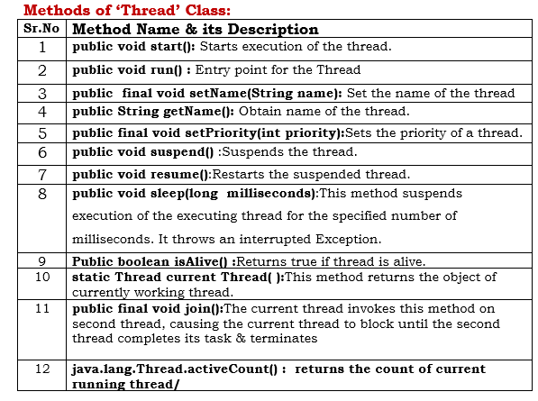
Multithreading

Slide 8
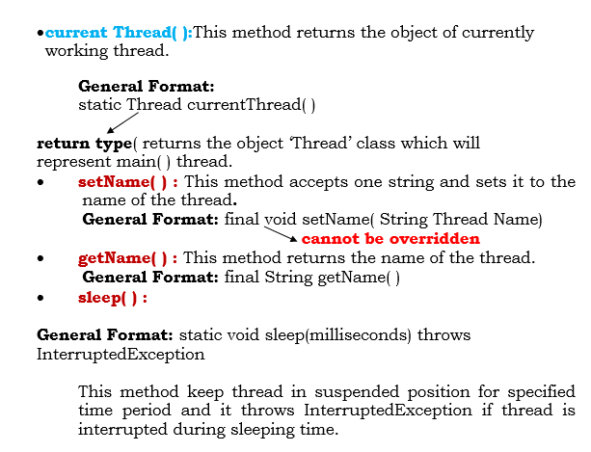
Multithreading

Slide 9
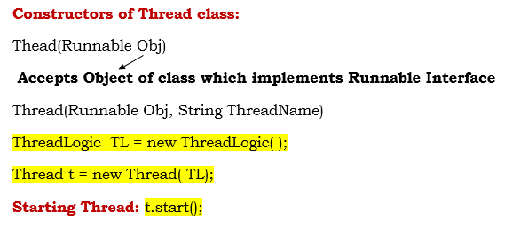
Multithreading
Demonstrating main( ) thread:
Code-1:
Daemon thread is a low priority thread which runs intermittently in the background doing the garbage collection operation for the java runtime system.

Slide 10

Multithreading
The Runnable interface holds run( ) method which holds logic of thread. We can write a class implementing Runnable interface and overriding run( ) method.
Creating child thread means creating object of ‘Thread’ class, for this purpose Java provides following two constructor.
Thread(Runnable Obj)
Thread(Runnable Obj, String ThreadName)
Above constructor accepts object of a class implementing Runnable interface.
After creating thread we need to start it so that it should begin the execution of its run( ) method. For this purpose Java provides following two method of ‘Thread’ class.
void start( );
t.start( );
Code-2:

Slide 11
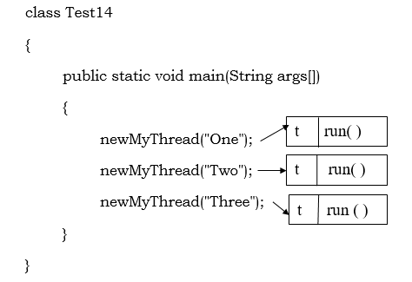
Multithreading
Note: Control of the program cannot be passed to the Thread because Thread works randomly and concurrently.
Code-3:
Creating Multiple Child Thread:
Code-4:

Slide 12
Multithreading
Extending Thread: When any class extends Thread class the object of that class becomes child Thread.
Code-5:
Runnable(Interface) VS Thread(Class):
It is a little confusing why there are two ways of doing the same thing in the threading API.
It is important to understand the implication of using these two different approaches. By extending the thread class, the derived class itself is a thread object and it gains full control over the thread life cycle.
Implementing the Runnable interface does not give developers any control over the thread itself, as it simply defines the unit of work that will be executed by a thread.
Another important point is that when extending the Thread class, the derived class cannot extend any other base classes because Java only allows single inheritance.
By implementing the Runnable interface, the class can still extend other base classes if necessary.
To summarize, if the program needs a full control over the thread life cycle, extending the Thread class is a good choice, and if the program needs more flexibility of extending other base classes, implementing the Runnable interface would be preferable. If none of these is present, either of them is fine to use.

Slide 13
Multithreading
Class Myclass extends Applet implements Runnable – OK
Class Myclass extends Applet, Thread - will not work
Implements Runnable | Extending Thread
More Use | Less Use
Used for multiple inheritance | Does not support multiple inheritance.

Slide 14
Multithreading
Methods of ‘Thread’ Class:
isAlive(): This method returns true if thread invoking method isAlive( ) otherwise it returns false.
General Format: final boolean isAlive( )
join() : The Thread in whose body we call join() method , it suspends. It can not leave suspended position until and unless thread invoking join() method does not complete its task and terminates.
The join() method of a Thread instance can be used to “join” the start of a thread’s execution to the end of another thread’s execution so that a thread will not start running until another thread has ended. If join() is called on a Thread instance, the currently running thread will block until the Thread instance has finished executing.
General Format: final void join ( ) throws InterruptedException

Slide 15
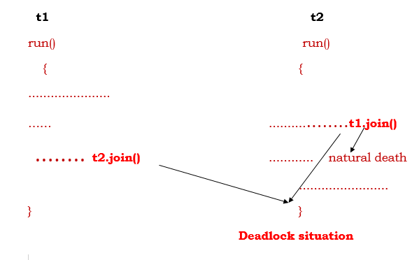
Multithreading
Methods of ‘Thread’ Class:
Code-6:

Slide 16
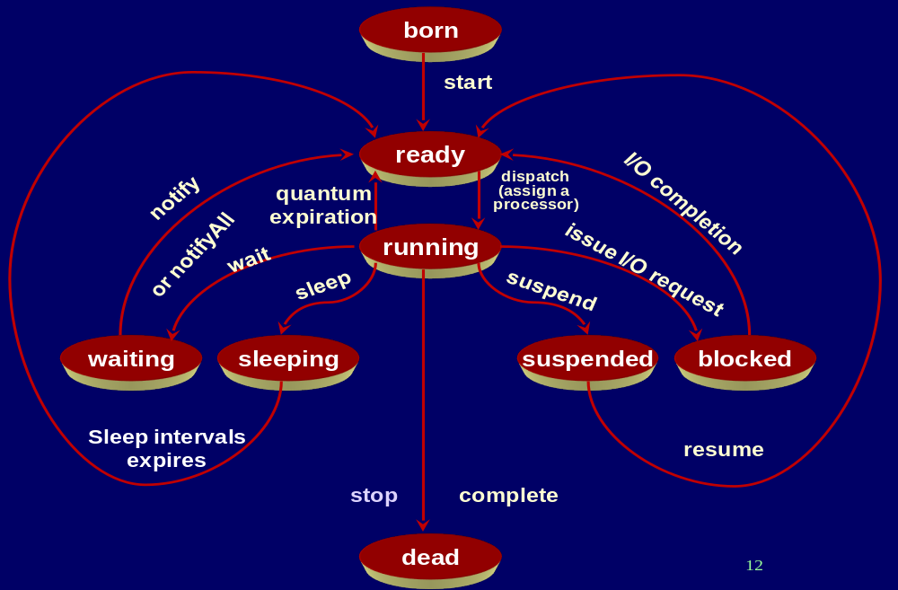
Multithreading
Life Cycle of Thread:

Slide 17
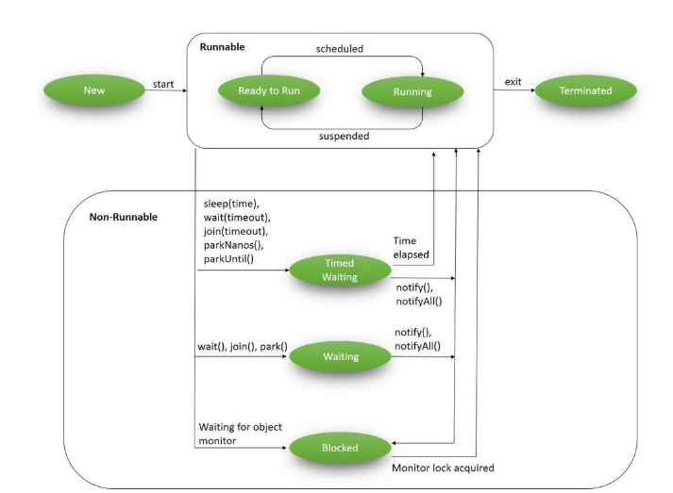
Multithreading
Life Cycle of Thread:

Slide 18
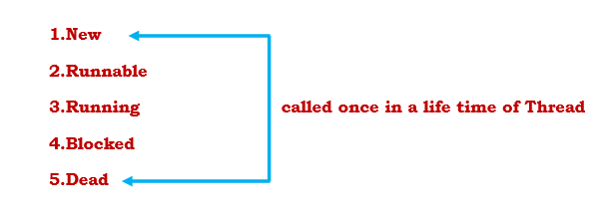
Multithreading
Life Cycle of Thread:
1.New: When Thread is created using new operator, it is in born state not in running state. When thread is in born state no code inside it is being executed.
2.Runnable: (Ready to run) Once the start( ) method is invoked the thread is in ready to run state. It may not be yet running .It is up to the operating system to schedule the thread execution. If it gets the CPU time and we start thread it comes in Runnable state.

Slide 19
Multithreading
Life Cycle of Thread:
3.RunningState:Once the thread goes to running state or starts execution, it acquires CPU time and memory and it executes its logic.
4.BlockedState:When the thread is in running state and is suspended due to any reason, it is in blocked state. After the end of the block state, thread comes in Runnable state.
The thread enters blocked state when one of the following event occurs:
Someone calls sleep( ) method of Thread class.
Someone calls suspend( ) method of thread class
The thread calls wait( ) method
The Thread is moved back to Runnable state from blocked state when one of the following occurs:
If the thread is put to sleep( ), the specified sleep time elapsed
If the thread is suspended, another thread calls its resume( ) method
If the thread is blocked by calling an wait( ), then can be resumed by calling notify( ), notify All( ).
If the thread is blocked on I/O, the specified I/O operation completes.

Slide 20
Multithreading
Life Cycle of Thread:
5.Dead: After completion of its logic thread goes in dead state. A thread is dead for one of the following reasons:
It dies a natural death because the run( ) method exits.
It is killed because someone invoked its stop( ) method.
To find whether the thread is alive, we have isAlive( ) of thread class.
Code-7:

Slide 21
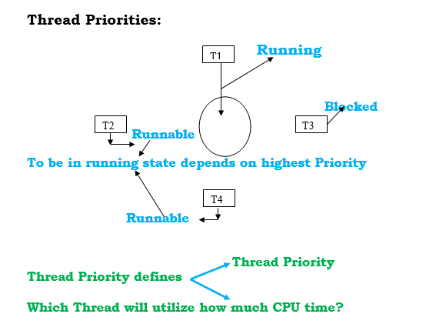
Multithreading
Thread Priority:

Slide 22
Multithreading
Thread Priority:
Thread priority defines following two things-
If multiple threads of a process are working concurrently and running thread of a process is suspended or terminated or blocked, then which thread among runnable state threads will take on CPU time? (The thread with highest priority has more chances.)
If multiple threads of a process are working concurrently for specified time period then which thread will take on how much CPU time? (The thread with higher priorities will utilize most of the CPU Time).
Range of ThreadPriority :--1 to 10
To specify thread priority, java provides following 3 static & final integer variables of ‘Thread’ class:--
Thread.MIN_PRIORITY Value=1
Thread.NORM_PRIORITY Value=5
Thread.MAX_PRIORITY Value=10

Slide 23
Multithreading
Thread Priority:
To set & get thread priorities, java provides following methods of ‘Thread’ Class:--
setPriority():-- final void setPriority( int p)
getPriority() :-- final int getPriority()
Code-8:

Slide 24
Multithreading
Synchronization:
With respect to multithreading, synchronization is the capability to control the access of multiple threads to shared same resources. Without synchronization, it is possible for one thread to modify a shared object while another thread is in the process of using or updating that object's value. This often leads to significant errors.
When a common resource in memory is being utilize by multiple clients concurrently, some logical problem may raise in system due to concurrency. Such system is known as Asynchronous System.
In multithreading code also when an object in memory is accessed by multiple threads concurrently partially or fully, system may become asynchronous. But every object in memory in Java is covered by monitor or Semaphore. By default this monitor is deactivated. When we activate this monitor, no two threads can access that object or part of object concurrently but they can access it one by one. This automatically synchronizes system.
No two threads can access same object concurrently in memory at same point of time.

Slide 25
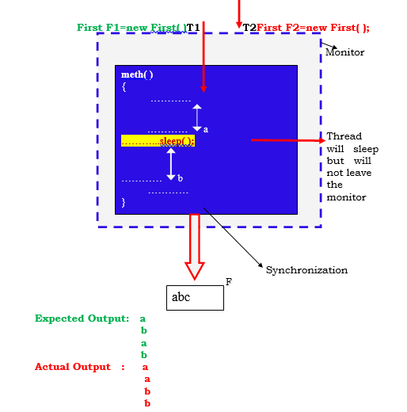
Multithreading
Synchronization:

Slide 26
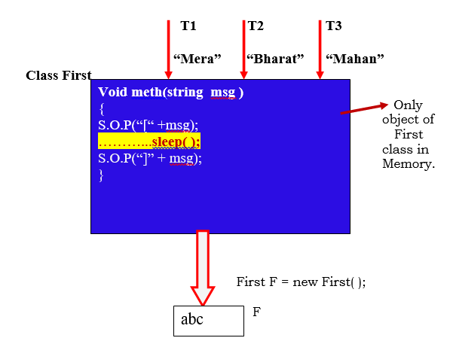
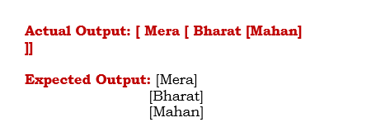
Multithreading
Synchronization:
Code-9:

Slide 27
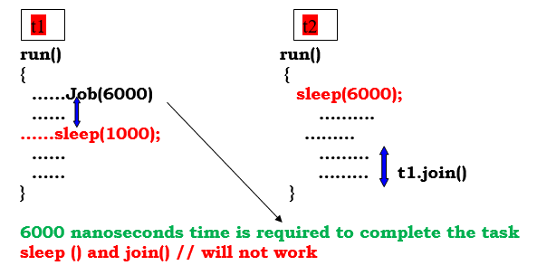
Multithreading
Inter -thread Communication:
Interthread Communication: It is used to govern the sequence of thread

Slide 28
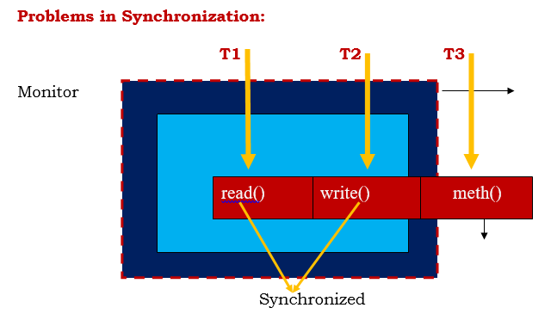
Multithreading
Inter -thread Communication:
T2 thread cannot access write() method because it is under monitor( read() and write() is synchronized)
T3 can access meth () method because it is not synchronized
How much time CPU will take to complete a task is not determined by multithreading

Slide 29
Multithreading
Inter-thread Communication:
Monitor is used to lock the resources. Without synchronization we can not get the effect of Interthread communication.
Though thread represents an individual path of execution, many times threads hold some logic which effect each-other. Many times this dependency may lead to some unexpected results of program. This can be avoided by establishing communication among threads.
sleep() method of Thread class suspends the thread but does not leave the monitor.
wait() method of object class suspends the thread(T1) and leaves the monitor and remains suspended till (T2)thread will not call notifyAll() method.
Java provides following methods of ‘Object’ class for communication:
wait():-- final void wait() throws InterruptedException
The thread in whose body we call this method is blocked & that thread leaves current
monitor. It remains blocked till any other thread entering same monitor doesn’t notify it.
Suspends the current thread till other thread will not call notify() method.

Slide 30
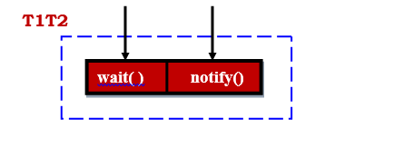
Multithreading
Java provides following methods of ‘Object’ class for communication:
notify():-- final void notify()throws InterruptedException
This method ends the blocked state of waiting thread & thread comes in runnable state.
Wakes up the first thread that called wait() method on same object
notifyAll():--final void notifyAll()throws InterruptedException
Wakes up the all thread that called wait() method on same object. The highest priority
thread will run first.
T2 thread will call notify() method then thread T1 will again starts executing its logic.

Slide 31
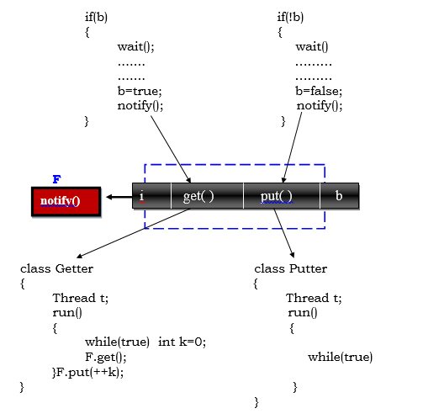
Multithreading
Interthread communication:

Slide 32
Multithreading
Interthread communication:
Code-10:
Code-11:
wait() | sleep()
The wait() method is defined in Object class. | The sleep() method is defined in Thread class.
wait() method releases the lock. | The sleep() method doesn't releases the lock.

